Slide 1

ScoreSight – Predicting EPL Points Tally, Match Winners & Top Assists
Data-driven predictions for the English Premier League (EPL)
Presented by: Ayush | Lovely Professional University | AI Intern at Infosys springboard

Slide 2

Introduction & Context
The Challenge of Forecasting Football
Problem Statement
Predicting outcomes in top-flight football leagues like the English Premier League is complex due to inherent variability, player dynamics, and external factors. Traditional analysis often relies on qualitative assessment.
Forecasting volatile match results (Win/Loss/Draw).
Quantifying individual player performance (e.g., Expected Assists).
Aggregating predictions for season-long points tallies.

Slide 3
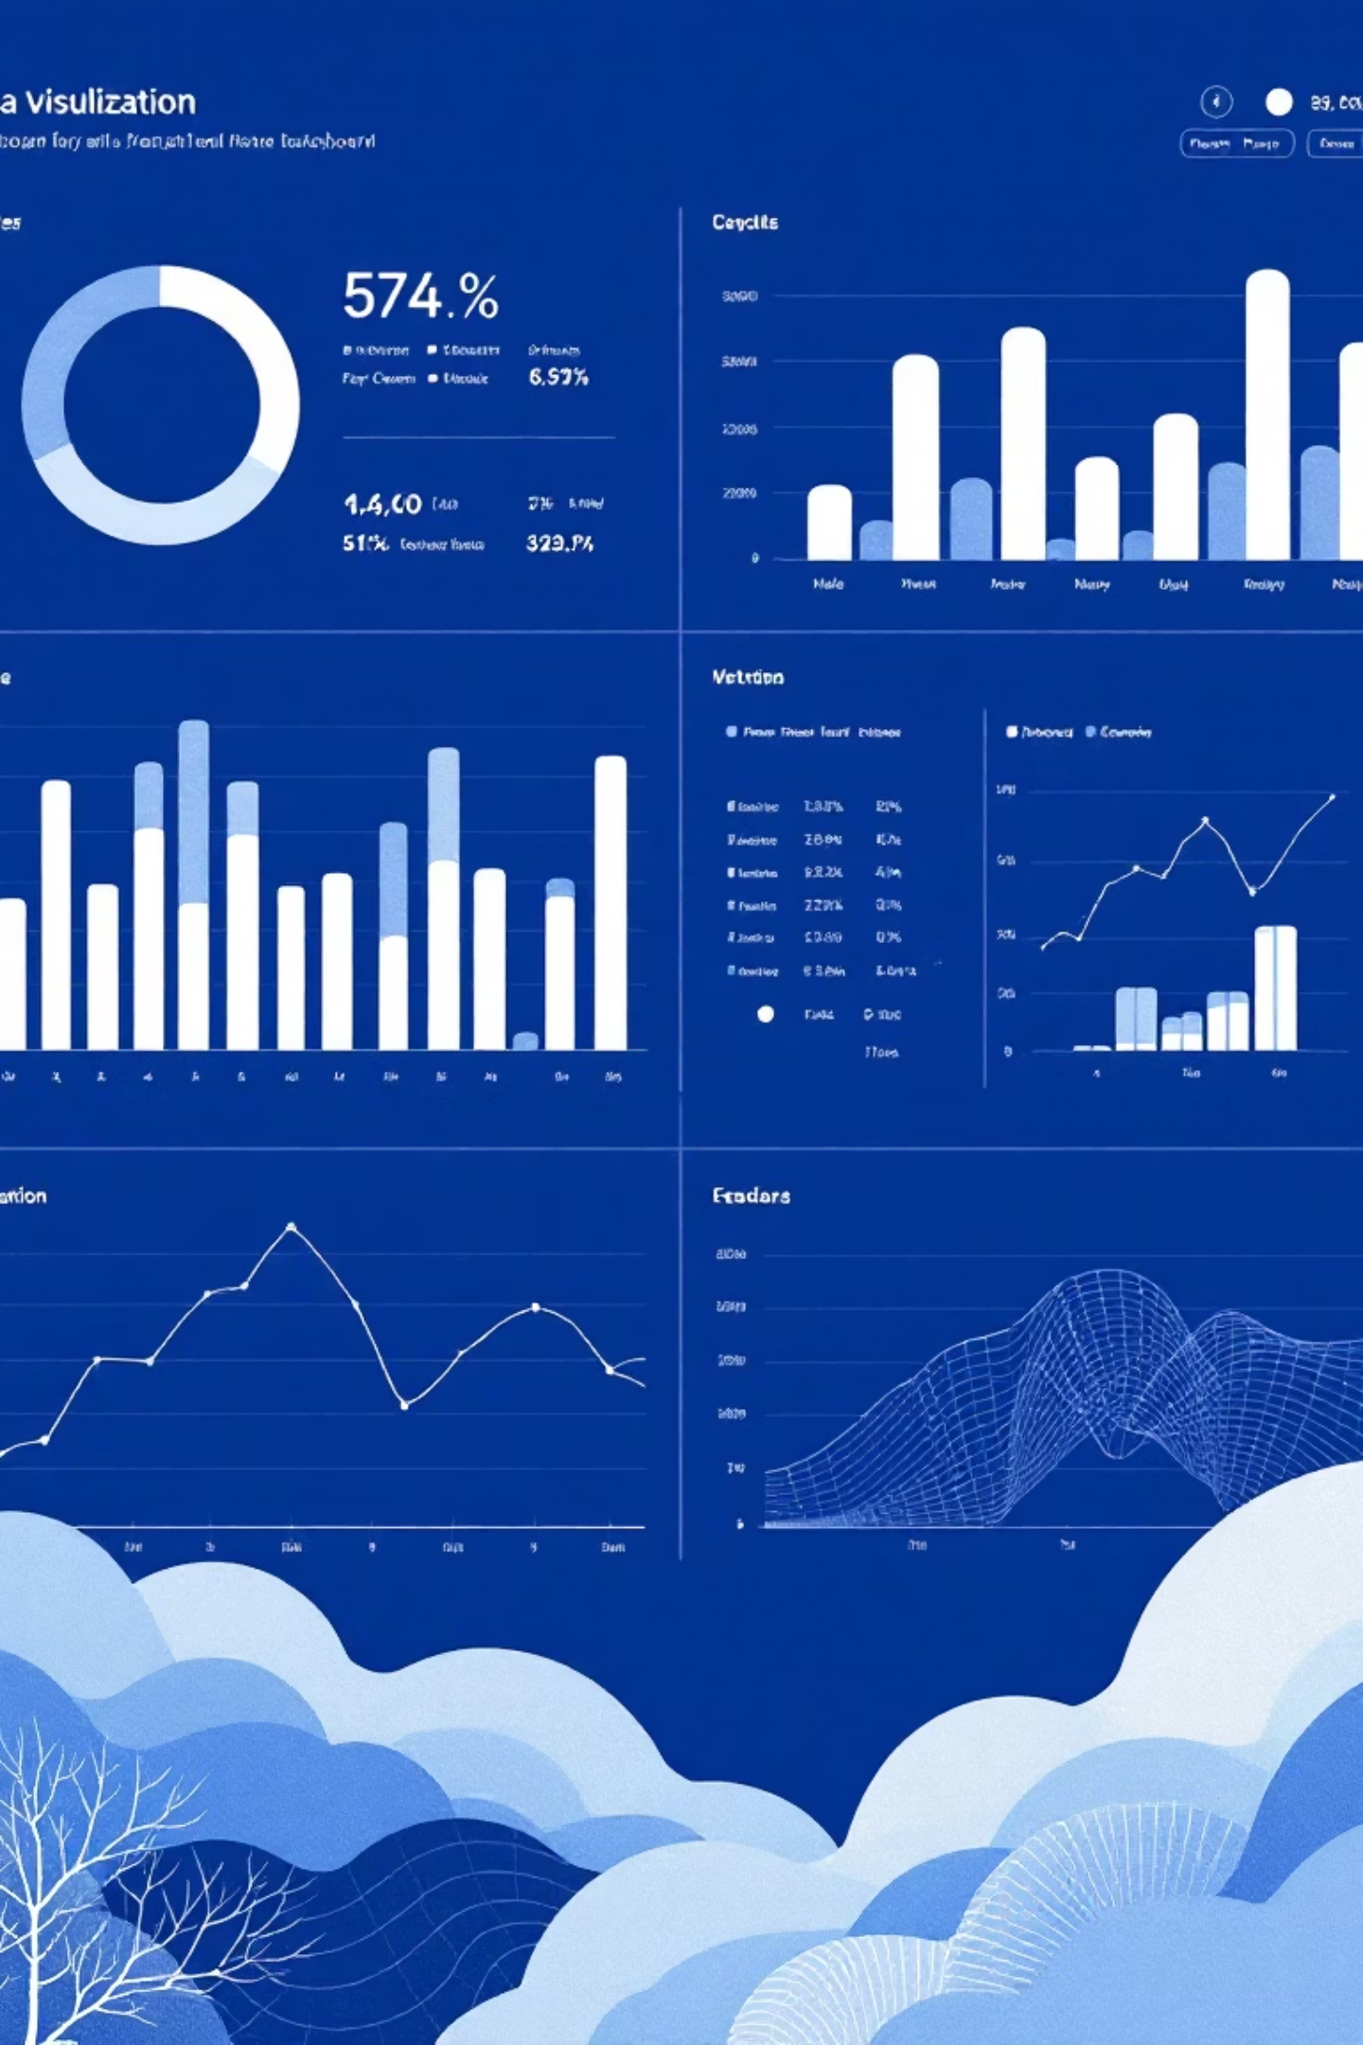



Project Scope
Predict Team Results
Develop classification models to forecast individual match winners and subsequent league points tally for all 20 teams.
Forecast Top Player Assists
Build regression models to predict the expected number of assists for key players in the upcoming EPL season.
Build & Evaluate Models
Establish robust evaluation frameworks using historical EPL data to ensure model validity and interpretability.

Slide 4


Key Applications of ScoreSight
🏆 Match Result Prediction
🎯 Player Assists Prediction
A high-accuracy classification model used to forecast the winner of specific fixtures. This feeds directly into the predicted final league standings and total points tally.
A regression-based model that generates an Expected Assists (xA) metric for players, forecasting individual contributions for the new season.

Slide 5
Dataset Overview: The Engine Room
Our models were trained on comprehensive historical data spanning multiple English Premier League seasons, ensuring a robust foundation for pattern recognition.
Core Feature Categories
Feature
Type
Range
Relevance
Historical Match Data: Previous results, scorelines, and match events.
Team A/B Strength
Numeric
100-2000
Match Winner
Team Features: Current form, Home/Away advantage, strength ratings (ELO or similar).
Home/Away
Binary
0 or 1
Match Winner
Player Statistics: Goals, Shots, Key Passes, Minutes Played, and Positional data.
Key Passes (P90)
Numeric
0.0-5.0
Assists Tally
Data was sourced from reputable sports statistics APIs and publicly available datasets.
Minutes Played
Numeric
0-3420
Assists Tally

Slide 6





Data Preprocessing Pipeline
A structured approach was critical to transforming raw football data into features suitable for Machine Learning models.
Data Acquisition
Collecting raw JSON/CSV data from various sources and merging into a unified dataset.
Cleaning & Imputation
Handling missing values (e.g., injury gaps) and correcting inconsistencies in player names or team IDs.
Feature Engineering
Creating new features such as rolling averages, goal differentials, and converting categorical data (e.g., position) using one-hot encoding.
Scaling & Normalisation
Applying Min-Max scaling or Standardisation to numerical features to prevent dominance by features with large magnitudes.

Slide 7

Model Architecture Flow
Two distinct modelling approaches were deployed: Classification for match outcomes and Regression for continuous assist totals.
Predicted Assists
Match Data input
Estimated assists
Features for outcome
Regression Model
Classification Model
Preprocessing
Linear Regression
Random Forest
Player Stats input
Match Winner
Predicted outcome
Season metrics
This modular architecture allows for specialized tuning of each predictor based on its unique performance metrics and feature requirements.

Slide 8


Deep Dive: Predictor One
🏆 Match Winner Predictor
Classification Approach
Model Type: Ensemble method (Random Forest Classifier) was used for its robustness against overfitting and ability to handle non-linear relationships.
Key Features: Incorporating weighted historical performance and home/away factor proved most influential.
Performance Highlight: The model achieved 64% accuracy on the unseen test set, significantly outperforming random chance.
The 64% accuracy is a strong result considering the highly stochastic nature of EPL match outcomes, where draws and unexpected results are common.

Slide 9

Deep Dive: Predictor Two
🎯 Player Assists Predictor
Regression Approach
Model Type: Multivariate Linear Regression, chosen for interpretability and speed, predicting a continuous numerical output.
Core Features: Focused heavily on creative metrics like "Key Passes per 90 Minutes" and "Previous Season's Assist Count".
Output: Generates a clear, actionable forecast for the expected assist tally for any given player in the upcoming season.

Slide 10



Evaluation Metrics & Results Summary
Rigorous evaluation ensured the reliability and practical utility of both models.
Match Winner Metrics
Assists Predictor Metrics
Insights & Realism
Evaluated using Accuracy (64%), Precision, and Recall to measure classification quality and balance between prediction types.
The predictions align with domain knowledge, identifying key creative players while allowing for realistic seasonal variance and team dynamics.
Evaluated using Mean Absolute Error (MAE) and Root Mean Square Error (RMSE) to quantify the magnitude of prediction errors.

Slide 11

Thank You
Thank you for reviewing this material. We can now transition to technical discussions, focusing on implementation details, model design considerations, and future opportunities for refinement.

